Slide 1



Vendée Globe Group 1
April 2023

Slide 2
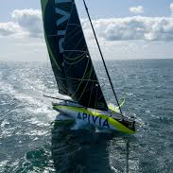
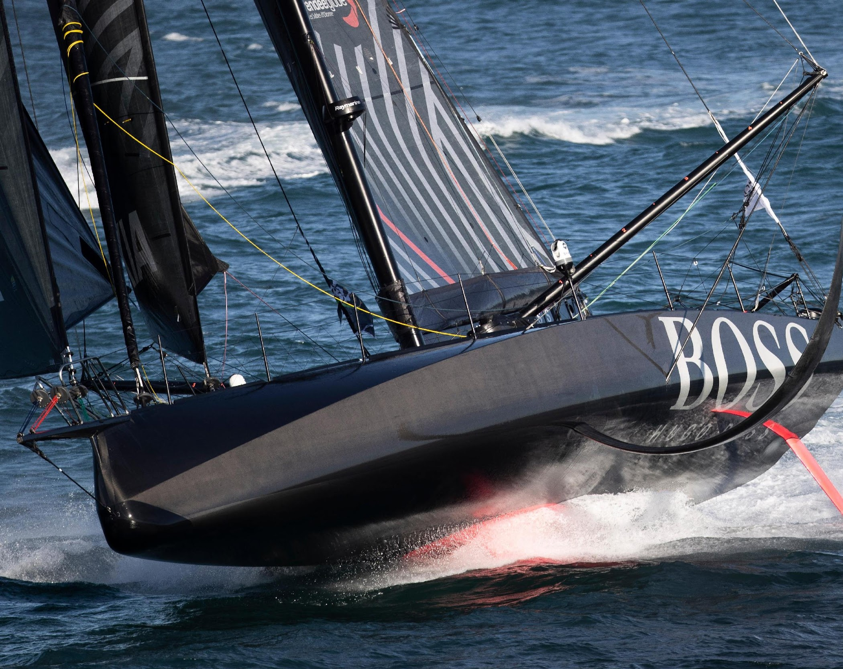
OVERVIEW
Business Requirements
Work Plan
Architecture
Challenges
Dashboard

Slide 3
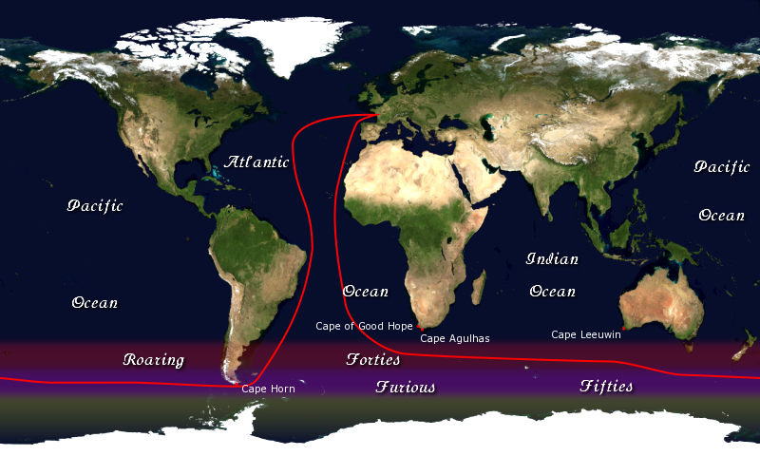
THE RACE
3
Notes:
The Vendée Globe is a solo non-stop round the world sailboat
race founded by Philippe Jeantot in 1989. The race takes place
every four years. Our team has made a dashboard tracking the data from live sensors of the boats. Speaking of our team is Sree, Loes, Eva, Abigail and me Nihal

Slide 4
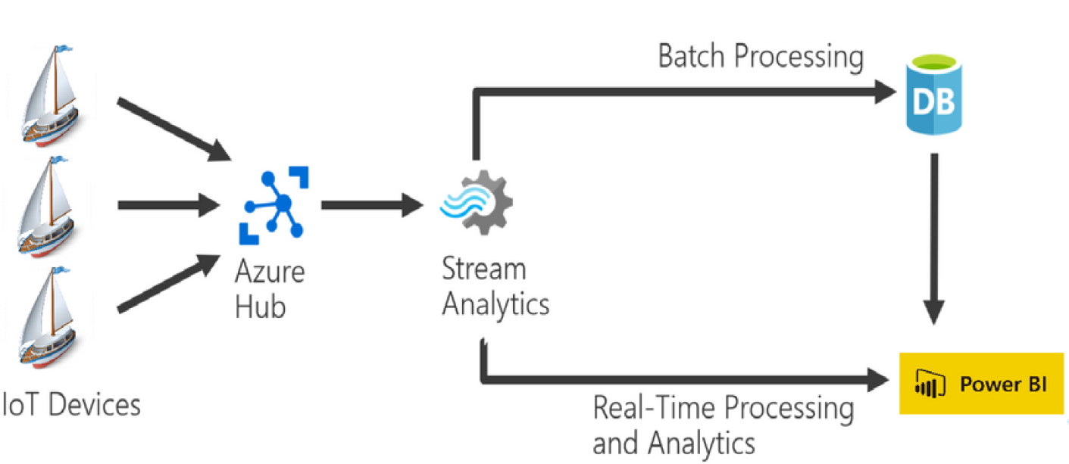
THE GOAL
4

Slide 5







WORK PLAN
CREATING ENVIRONMENTS
SET-UP SIMULATOR
STREAM DATA
BATCH DATA
DASHBOARD

Slide 6
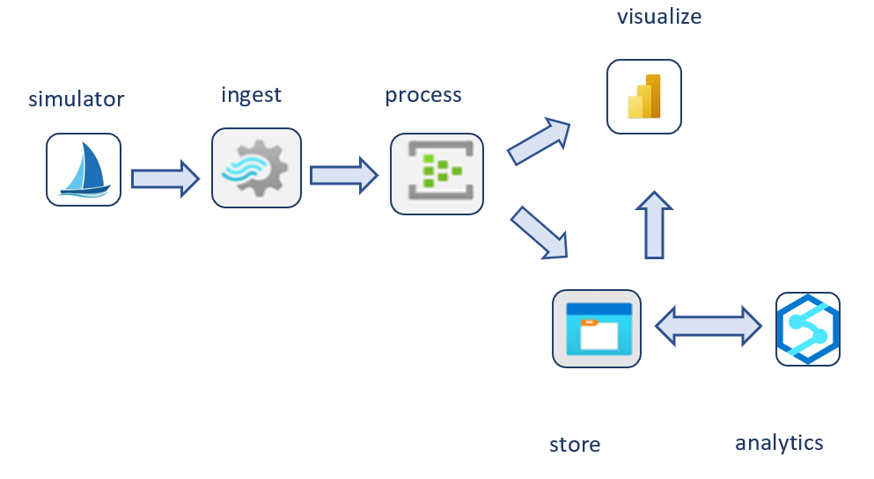
DATA JOURNEY
6

Slide 7
FIRST DECISIONS
Parquet file
Data Lake
Serverless SQL Pool
7

Slide 8
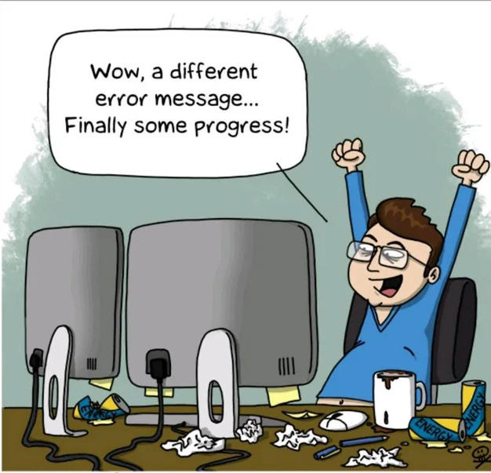
CHALLENGES

Slide 9
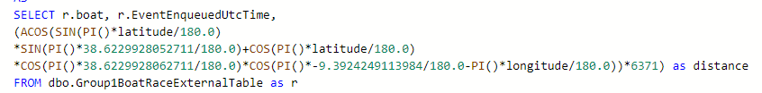
CHALLENGES
Distance formula worked at first
….than did not!

Slide 10
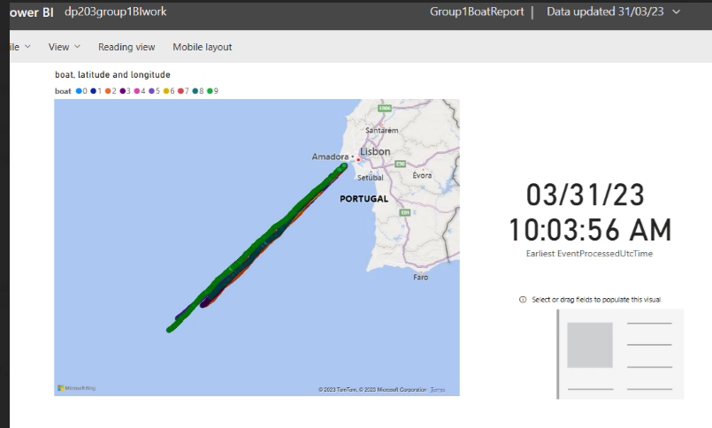
CHALLENGES

Slide 11
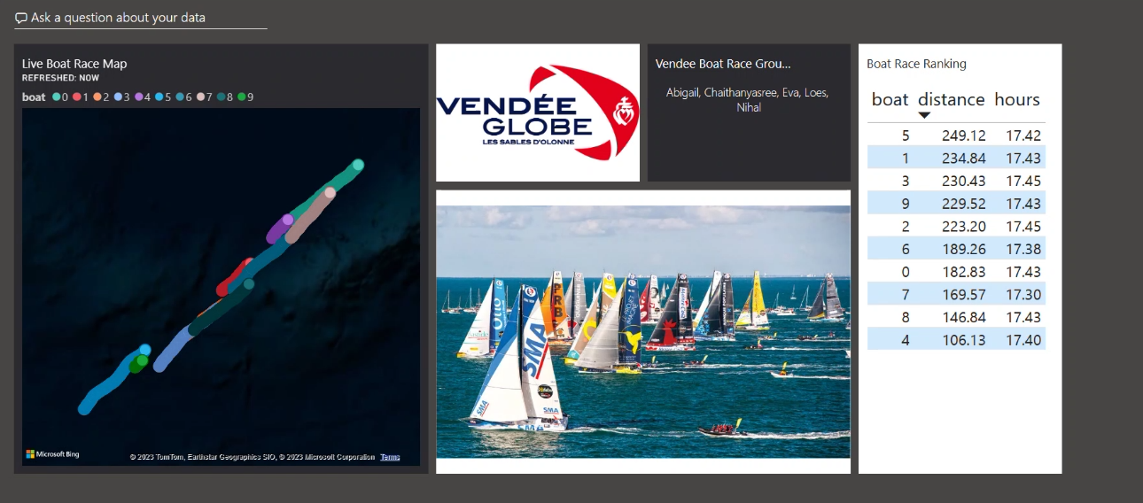
DASHBOARD

Slide 12

THANK YOU

